Slide 1
Cybersecurity
Viruses and Worms

Slide 2

Virus
Self-replicating malware
Does not need you to do anything
Does ride atop other program
Replicated through OS or network
Executing a program can spread a virus
May or may not cause problems
Some viruses destroy
Some viruses actually fix problems
Neither want or need your consent
Antivirus is common solution
New “strains” every week
Stay up to date!

Slide 3

Types of Viruses
Program viruses
Bundled with application
Common in pirated software
Boot sector virus
Operates outside the operating system
Script
Operates in OS and browser
Application macros
Microsoft Office popular target

Slide 4

Worms
Self-replicating malware
Does not rely on user
Utilizes network to spread
Quickly self-propagates
Can take over multiple systems very quickly
Firewalls and IDS/IPS help prevent worms from spreading
Will not prevent infestation once worm is on network

Slide 5






How it spreads

Slide 6
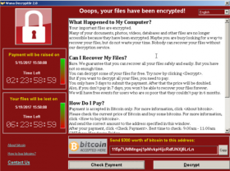
How it spreads

Slide 7
How it spreads

Slide 8
How it spreads

Slide 9
How it spreads

